Slide 1
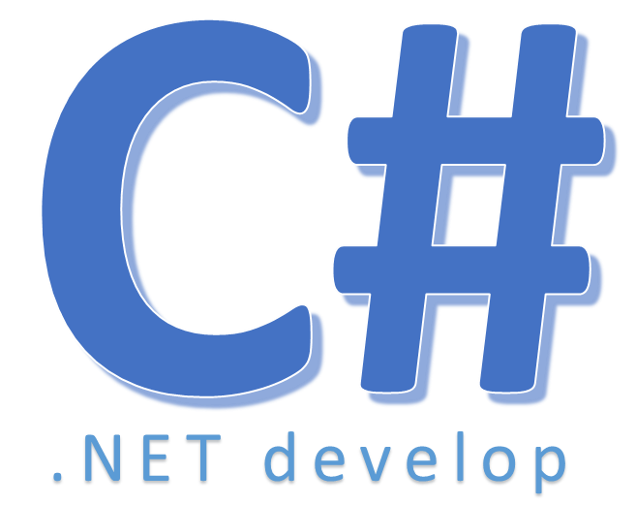

Exists

Slide 2
Exists
Determines whether the specified array or list contains any elements that match the conditions defined by the specified predicate

Slide 3


Hey! Coding is easy!
END

